Slide 1
Luther, Malcolm and Thabo ESP car project

Slide 2
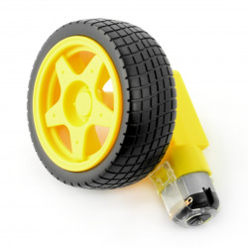
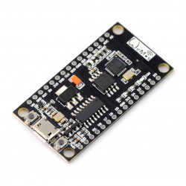
Parts Used
2 x DC motor + wheel
ESP 8266

Slide 3
3D printed body of our own design

Slide 4
Car Design

Slide 5
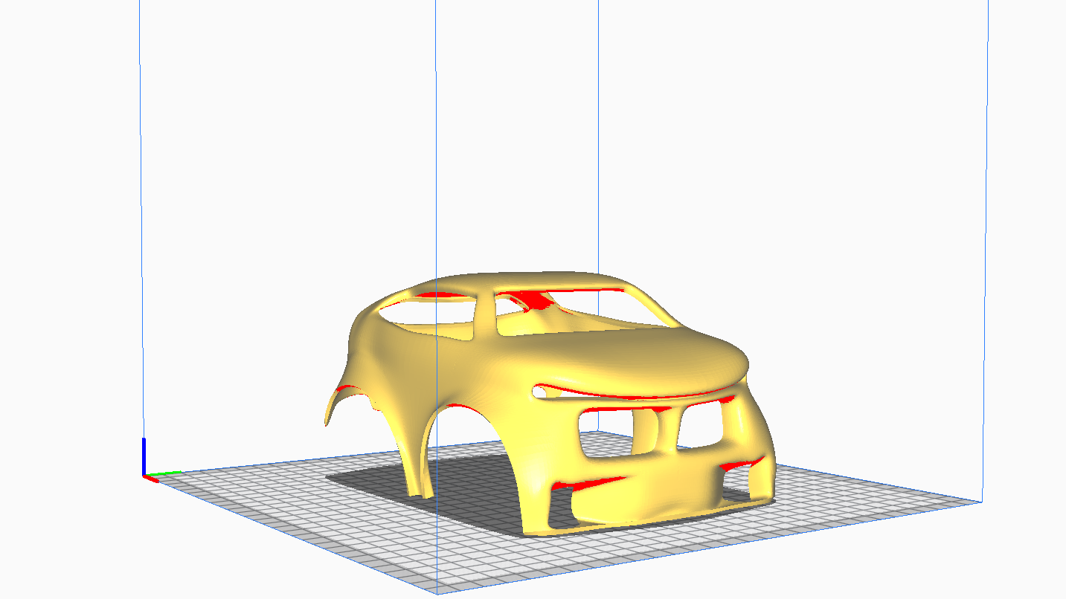
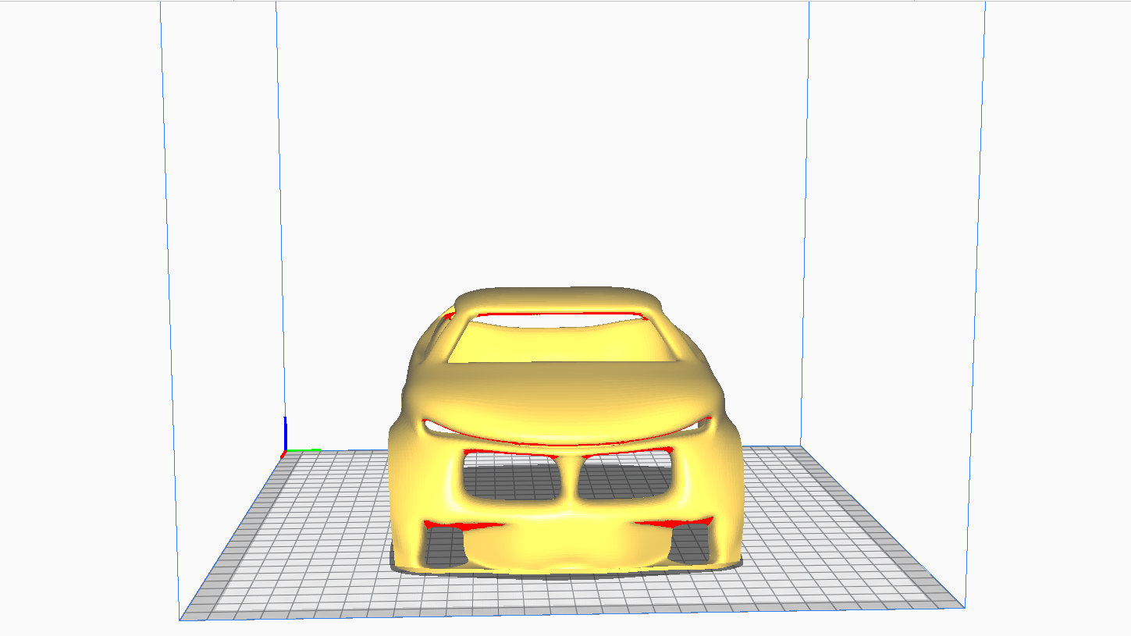

Slide 6
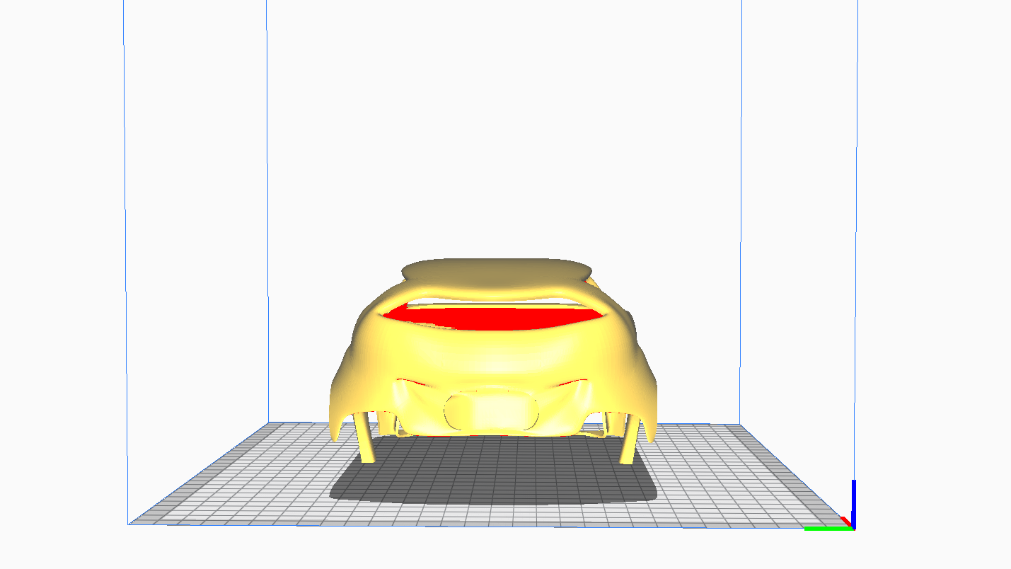
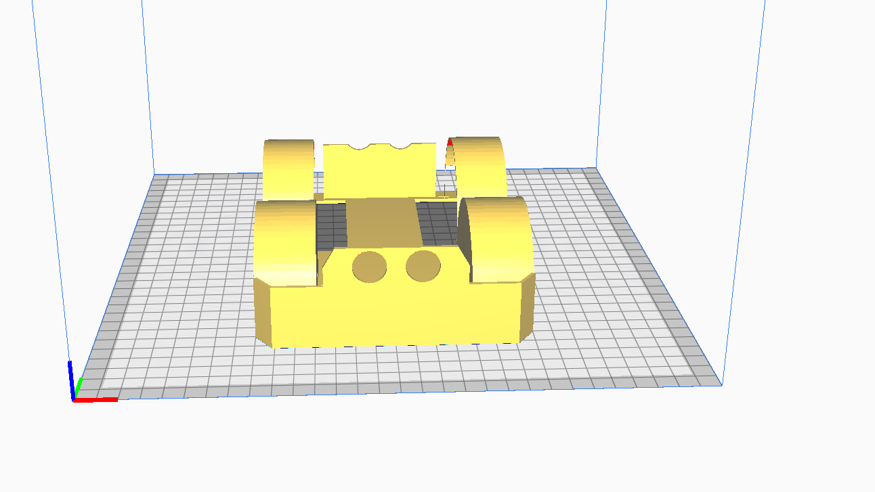

Slide 7
